Slide 1
The Future of Software engineering
Sekou Traore

Slide 2
Context
The paper was written by James Herbsleb, Christian Kastner, and Christopher Bogart from Carnegie Mellon University.
Their research interests cover a range of interesting topics like human-computer-
Interactions, Socio-technical systems and software system variability
Its main goal is to improve the efficiency of the software engineering process by applying analytics to data from all phases of the SDLC.

Slide 3
The problem
Innovative transparent environments like distributed version control systems(Github, Bitbucket, launchpad) have created a trend towards more openness in software development.
Community-focused development bears inherent risks like the use and combination of foreign or unsafe code.
Development increasingly became a matter of choosing the right tools for the job.
Intelligent selection of said tools can significantly speed up the production and performance of software

Slide 4
The proposed solution
Relies on 2 interdependent concepts
The concept of Intelligent transparency refers to the use of the data generated by transparent environments to further improve development.
ISAM or Intelligent software assurance monitoring providers implement intelligent transparency.

Slide 5
Hypothetical scenario
The IRS decides to release an anonymous version of their tax return database.
A generic company TaxCoders sees the opportunity and decides to create a tax software using the data.
An ISAM provider identifies different ensembles that are suitable for the task
These ensembles can consist of programming languages, web frameworks, and databases.

Slide 6
Hypothetical scenario Pt2
The ISAM provider applies the analytics to data and quickly finds candidate ensembles.
The correct application of specific information can help identify and eliminate buggy components, avoid immature and volatile components, detect fault-prone ensembles, and tailor the final predictions to the customer’s needs.
The provider uses a variety of community variables like the number of forks, commit histories, and developer profiles to cite a few.
Candidate ensembles are then ranked by quality and risk profiles.
The final ensemble is chosen depending on the context of the project.

Slide 7
A new type of software maintenance implemented by efficient monitoring and preventive risk handling

Slide 8
Efficient monitoring
The provider monitors signs of community deterioration such as reduced repo activities, the number of unaddressed bugs, and increases in compatibility-breaking changes.
The provider then steps in with notifications of suggested changes that help the software keep up in terms of performance and security

Slide 9
Risk Handling
Risk handling is supported by 2 major ideas
Transparency enhancement with analytics and Runtime data analysis
Transparency enhancement allows developpers to get ahold of otherwise hidden data to help in decision making
Runtime analysis uses runtime data from software packages to help fine tune maintenance

Slide 10
A New Type of Software maintenance
Transparency enhancement
Runtime data monitoring
Uses various “signals” to infer useful data
Signals that the project is “alive”
like commit velocity, diversity of committers ,number of people interested(stars),number of test cases.
These signals are then used to infer if the project is skillfully managed and well received by the community
Early adopters of new components are used as field testers by the ISAM provider
The rate of adoption and results is made visible to the more risk averse developer community to attract them
In practice the provider will deploy and monitor packages of softwares early adopters might want

Slide 11
A New Type of Software maintenance
Transparency enhancement
Runtime data monitoring
Tools like Github visualizer and Gemnasium can help automate the discovery of that hidden information
By letting developpers focus on what matters most, transparency enhancement can create awareness to prevent disruptions in the open source development model.
The final step of the process gathering data from the adopters to make it available to new customers

Slide 12
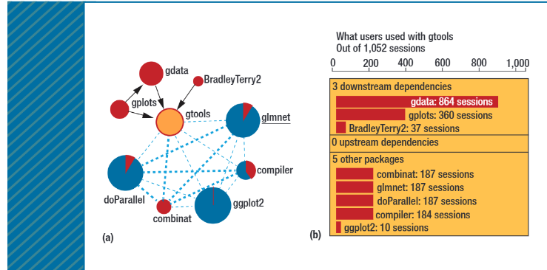

Slide 13
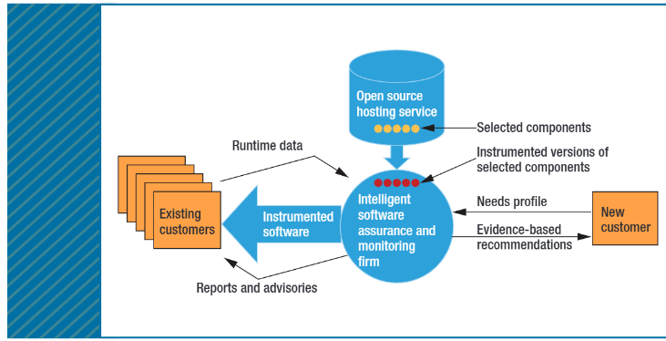

Slide 14
Exciting Future possibilities
Will help establish a virtuous circle of wider adoption of efficient tools
Advances in the ISAM model will allow transformative changes like predicting the probability that a specific pull request will be accepted, a project’s future activity level and a historigram of codebases broken down by key use attributes
Significantly help decision making by providing the customers with relevant information

Slide 15
Thank you!

